Slide 1
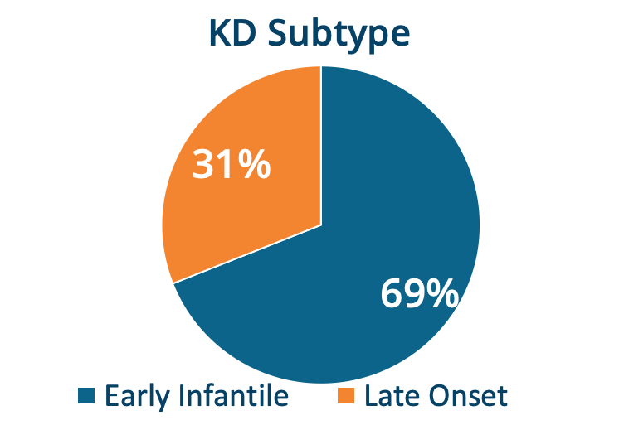
Disease Burden and Treatment Considerations in Krabbe Disease: The Caregiver Perspective
WORLD #328
S Pike-Langenfeld ¹, DA Laney ¹, A Rugari¹, CZ Ogg ¹
¹ KrabbeConnect
Background
Results
Diagnosis & Treatment Experience
Krabbe disease (KD), also known as globoid cell leukodystrophy, is a devastating, demyelinating lysosomal disorder. ¹
In order to better understand the KD caregiver perspective, KrabbeConnect, a non-profit KD patient advocacy foundation, sought to characterize disease burden and treatment considerations.
2 (15.4%) were diagnosed via a standard newborn screening program
2 (15.4%) were diagnosed in utero or at birth due to an affected sibling
9 (69%) were diagnosed based on symptom onset. In this group time to diagnosis ranged from 8-17 months
“When he was diagnosed by a neurologist, he did not tell us about transplant. We were talking about transplant with other diseases, but when Krabbe was confirmed he said there is nothing we can do.” (the child was later transplanted)
“The doctor knew nothing about Krabbe. Give resources to the doctor so that he has the basic information.”
“The doctors were divided on if we treat or not. We wanted to save our child. It was a leap of faith.”
“You don’t feel like you have a whole lot of options. We relied on info from other parents who have been through it and our doctor.”
Methods
Infantile-onset patients were most often described as having “relentless irritability” and loss of milestones. Later onset patients had a more varied presentation.
After diagnosis, the burden of disease caused increased emotional stress/worry. There was a steep learning curve about the care of the affected child including maintaining schedules, seclusion, fear, and financial security.
Parents reported additional stress as they encountered physicians without detailed knowledge about KD or available resources to connect them with experienced KD families.
Majority of survey participants felt that having multiple KD advocacy groups brings value to the community and leads to improved care.
Caregivers of non-transplanted children desired improved quality-of-life, while those of transplanted patients desired functional gains (i.e., walking and improved communication).
A wish to minimize risks and dangers of new therapies ranked as the number one priority among caregivers.
In partnership with Engage Health, a health research firm, formal qualitative research interviews with 11 caregivers were conducted.
Interviews included a broad cross-section of caregivers including those of early-onset KD and late-onset KD.
Caregivers were included who represented children who had undergone hematopoietic stem transplant (HSCT), those who did not undergo HSCT, individuals who were deceased due to KD, and individuals currently living with KD.
Categories of engagement included demographics, symptoms, age at diagnosis, diagnostic journey, treatment decisions, disease burdens, life impacts, therapeutic innovations, advocacy organizations and approaches to advances.
Conclusions
The caregiver voice provides additional insights into KD disease burden and how treatment decisions are approached.
Further research is needed to collect disease burden information in a comprehensive and representative manner and to bridge the gap between caregivers and those designing measures of future therapies.
These data will help guide the success of drug development in KD through better understanding of therapeutic goals from the caregiver perspective.
KrabbeConnect & Engage Health acknowledge and thank the survey participants.
Bascou N, DeRenzo A, Poe MD, Escolar ML. A prospective natural historystudy of Krabbe disease in a patient cohort with onset between 6 months and 3 years of life. Orphanet J Rare Dis. 2018;13(1):126. Published 2018 Aug 9. doi:10.1186/s13023-018-0872-9
WORLD February 10-13, 2020 Orlando, Florida

