Slide 1
Partner with Us
Program Insights

Slide 2
What is Partner with Us?
The opportunity for a family or an individual to establish a fund, utilizing KrabbeConnect’s non-profit platform and resources, to strengthen groundbreaking research, contribute towards a special project, or simply to aid other impactful efforts in the Krabbe disease space.

Slide 3
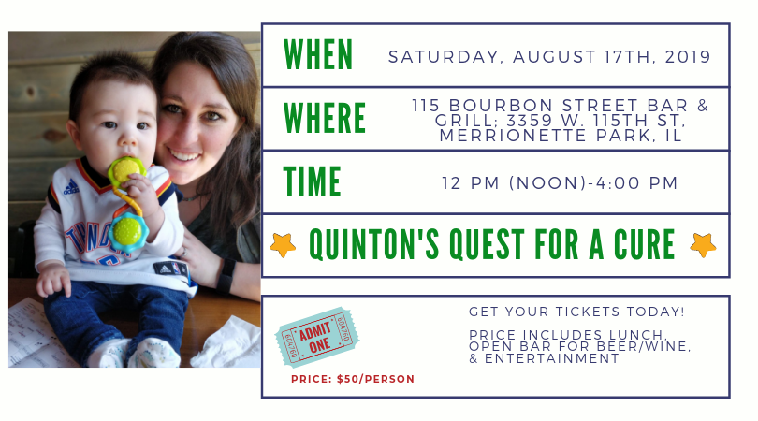
How Would It Work-Logistics
A family shows interest in setting up a fund. For Example: Quinton’s Quest for A Cure Fund.
If the family/individual agrees to the terms and conditions, they would petition the board a name for their fund.
Once the fund is set up, the family/individual can direct their network of people to give towards their family fund.
The family acts as advisors and successors to the fund in perpetuity.

Slide 4
Purpose of Program?
To give families a stronger voice and sense of ownership in the journey towards advancing curative work in Krabbe
Strengthen collaboration and teamwork within the Krabbe community
Allow families a powerful vehicle to aid efforts without establishing a foundation.

Slide 5
Fund vs. Foundation Comparison
Category | Family Advised Fund | Foundation
Start-up Time | Immediate | Can take several weeks or months
Start-Up Costs | None | Legal (and other) fees are typically substantial
Ongoing Administrative, Legal, and Accounting Fees | 5-10% | $3,000-$5,000/year or more
Privacy | Names of individual donors can be kept confidential if desired, and grants can be made anonymously | Must file detailed and public tax returns on grant, investment fees, staff salaries and more.
Reporting | None | Required annual state and federal tax returns-time consuming and requires an expert account in the non-profit space.
Governance | None | For incorporation purposes must develop by-laws and board documents overseen by a formal board

